Slide 1
Introduction to Python Programming for Fabric Developers
Rui Romana
Principal Program Manager
Power BI Customer Advisory Team (PBICAT)

Slide 2
Agenda
Python Execution Environments
Python Language Fundamentals
Programming with Built-in Python Data Structures
Programming with Pandas and Dataframes
Programming with Fabric Spark
Plotting and Visualization

Slide 3
Setting Up For Local Python Development
Local PC
Visual Studio Code
MyPythonCode.py
PyLance
Python Runtime

Slide 4
Executing Python Code in Old School Power BI
Local PC
Power BI Service
Personal Gateway
Python Visual
Power Query M Code
MyPythonCode.py
MyPythonCode.py
Database
Dataset
Python Runtime

Slide 5
Executing Python Code in Fabric
Microsoft Fabric provides built-in Python support for Apache Spark
Includes support for PySpark
Python code can be run through Spark batch job definition
Python code can be executed interactive Fabric Notebook

Slide 6
Apache Spark Architecture
Apache Spark is an open-source, unified analytics engine
Very popular for processing Big Data projects
Batch processing, large-scale SQL, machine learning, and stream processing
Spark is a general-purpose, cluster computing framework
can distribute data processing tasks across many nodes to process Big Data

Slide 7
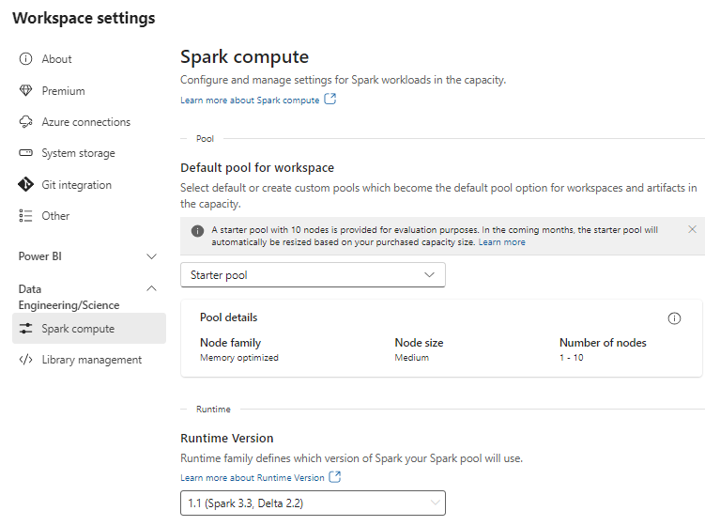

Slide 8
Fabric Notebooks
Notebook provides web interface to write and execute Python code
Language support for PySpark (Python), Spark (Scala), Spark SQL and SparkR
Allow author to mix [markup text] + [python code] + [visualizations] in single file
What are notebooks used for?
Apache Spark jobs
Machine learning experiments
Notebook structure
Notebooks created by adding cells

Slide 9
Notebook Sessions
Details to follow

Slide 10
Agenda
Python Execution Environments
Python Language Fundamentals
Programming with Built-in Python Data Structures
Programming with Pandas and Dataframes
Programming with Fabric Spark
Plotting and Visualization

Slide 11
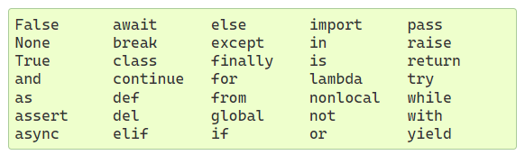
Python Fundamentals
Things about Python
It’s an interpretive language - not a language that gets compiled
Python code executes on a runtime layer
Getting started with Python syntax
Indentation – not braces
Everything is an object – objects have attributes and methods
Comments added using #
Keywords

Slide 12
Code Structure
Indents and continuation character
Indentation – not braces
Variables
Variables are created to reference objects
Variables do not have types – but the objects they reference have types
Variables point to objects
But variable and objects it points to are distinct

Slide 13
Importing Modules

Slide 14
Conditional Execution
If, elif and else
Equality | ==
Inequality | !=
Less than | <
Less than or equal | <=
Greater than | >
Greater than or equal | >=

Slide 15
Strings
String literals can be enclosed in single or double quotes
Use double quotes inside string created with single quotes or vice versa
Triple quote used to add literal quote into string
Formatted string preceded with f or F
Raw strings preceded with r or R

Slide 16
Extracting Slices from a String
ssss
[:] | Extract entire string
[ start:] | Extracts from start offset to end
[: end] | Extracts from start to end offset minus 1
[ start : end ] | Extracts from start offset to end offset minus 1
[ start : end : step ] | Extracts from start offset to end offset minus 1by step increment

Slide 17
String Functions
len()
split()
join()
replace()
strip()

Slide 18
Formatted Strings

Slide 19
Defining and Calling Functions
define using def
Passing arguments
What are Keyword Arguments

Slide 20
Explode/Gather Keyword Arguments with **
Explode/Gather positional Arguments with *
Explode/Gather Keyword Arguments with **

Slide 21
Functions Are Objects
Inner functions
Closures
Anonymous functions (lambda)
Generator functions

Slide 22
Object-oriented Programming Support
Inheritance and polymorphism
Multiple Inheritance
Mixins

Slide 23
Looping and Enumeration
while loops
for in
Caveat – often writing a loop is going to be very inefficient

Slide 24
Agenda
Python Execution Environments
Python Language Fundamentals
Programming with Built-in Python Data Structures
Programming with Pandas and Dataframes
Programming with Fabric Spark
Plotting and Visualization

Slide 25
Tuples
Tuple is fixed-length, immutable sequence of objects
Once created, tuple contents cannot be modified
Syntax for tuple uses parentheses
var1 = (2, 4, 6, 8)
Unpacking example
tuple1 = (2, 4, 6)
x, y, z = tuple1
a = 1
b = 2
// swap values
a, b = b, a

Slide 26
Lists
List is variable-length sequence of objects
Provides support for adding, updating and removing objects from list
Create list using square brackets []
Access list item using zero-based index
list1 = [1, 4, 6, 8]
list1[0] = 2
list1.append(10)
list1.insert(0, 2)
list1.sort()
Lists support slicing like strings
List1 = [1,2,3,4,5,6,7,8]
List2 = List1[2:4]

Slide 27
Tuples versus Lists
Tuples use less space
You cannot clobber tuple items by mistake
You can use tuples as dictionary keys
Tuples can be named

Slide 28
Dictionaries
Dictionary stores collection of name-value pairs
Dictionary data structure also known as associative array or hash map
Names and values are stored as objects
Dictionary created using curly braces {} with name-value pairs inside
Add or change and item by [ key ]
Retrieve using item(), keys() or values()
dictionary1 = {
"a": "value1",
"b": 42,
"c": [1,2,3],
"d": None
}
SecretOfLife = dictionary1["b"]

Slide 29
Sets
Unordered collection of unique elements
Created using either set function or curly braces
set1 = set( [1,2,2,3,4,4,4,5] )
set2 = {1,2,3,3,4,5}
Provides mathematical set operations like union, intersection and difference

Slide 30
Agenda
Python Execution Environments
Python Language Fundamentals
Programming with Built-in Python Data Structures
Programming with Pandas and Dataframes
Programming with Fabric Spark
Plotting and Visualization

Slide 31
Pandas Overview
Pandas built on top of NumPy library
NumPy defines datatypes for strings, integers, floats, dates, etcs
NumPy introduces concept of fast and efficient array-based functions
Array-based function can update column values without looping – much faster
Pandas focuses on programming tabular datasets with heterogenous data
With PyNum multi-dimensional array, all elements must be of the same type
With pandas, each column in tabular dataset can have a different datatype
Pandas Data Structures
Series
Dataframe
Index

Slide 32
Series Objects
Series is one-dimensional ordered sequence of values
Series models a column in a database table
All values in a series must have same type – based in numpy types
Series has index which is associative array of data labels
This allows Series to model a fixed-length, ordered dictionary

Slide 33
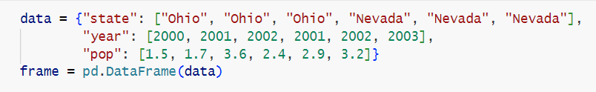
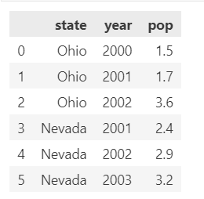
DataFrame Objects
DataFrame represents a rectangular table of data
DataFrame contains ordered collection of Series objects all sharing a single index
Each Series contains name and values for specific column
DataFrame contains index for both columns and rows
DataFrame is wrapper for dictionary of named, equal-length lists

Slide 34
DataFrame Index Objects
Index objects used to hold axis labels
This includes column names

Slide 35
DataFrame Operations
Reindexing

Slide 36
Agenda
Python Execution Environments
Python Language Fundamentals
Programming with Built-in Python Data Structures
Programming with Pandas and Dataframes
Programming with Fabric Spark APIs
Plotting and Visualization

Slide 37
Agenda
Python Execution Environments
Python Language Fundamentals
Programming with Built-in Python Data Structures
Programming with Pandas and Dataframes
Programming with Fabric Spark
Plotting and Visualization

Slide 38
Summary
Python Execution Environments
Python Language Fundamentals
Programming with Built-in Python Data Structures
Programming with Pandas and Dataframes
Programming with Fabric Spark
Plotting and Visualization

Slide 39
Named Tuples

Slide 40
Modules
What is a module
Hierarchical set of modules publish using packages

Slide 41
Managing Python Libraries in Fabric
Feed Library
Custom Library
Installing Workspace Libraries

Slide 42
Installing Python Libraires in a Notebook

